Slide 1
A Brief Introduction to Git
Jinlian Wang

Slide 2
What, another version control?
Git
SVN
Clearcase
CVS
Are they created Equal?

Slide 3
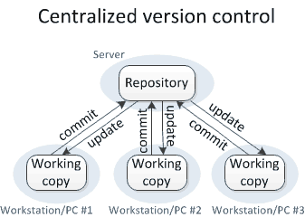

Slide 4
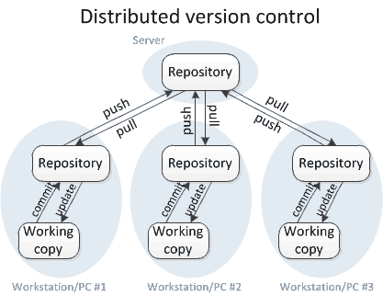

Slide 5
Git – Why I like it?
Distributed model
Local repository
Pull requests/code review
Branch switching

Slide 6
Common Commands – init/clone
Remote repository
Local repository
What does “cloning” mean?
Syntax:
Git clone <repo url>
Git init

Slide 7
Common Commands – check in
Working tree
Staging area (why it is good?)
Local only for now, remote check in later
Syntax:
Git add <file/dir/.>
Git commit -m “<msg>”

Slide 8
Git Branches
Light weight pointer to a commit
Syntax:
Git check out <branch>
Git check out -b <branch>
Git branch <branch>
Git branch -d <branch>
Git branch -m <branch>

Slide 9

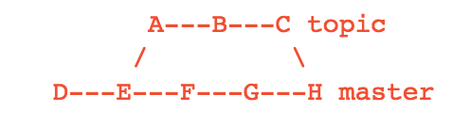
Common Commands – merge
Three way merge
Syntax:
Git merge <branch>
Git merge --abort
Git add <file>
Git commit -m “<msg>”
Git merge topic

Slide 10
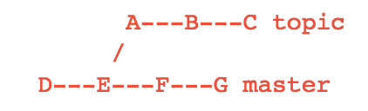
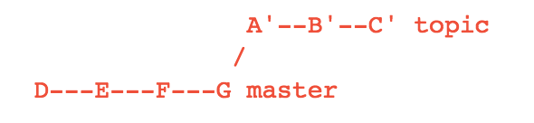
Common Commands – rebase
Fast forward merge
Syntax:
Git rebase <branch>
Git rebase --abort
Git rebase --continue
Git rebase --skip
Git rebase master

Slide 11
Merge vs Rebase
Non-destructive, preserve the entire history
Extraneous merge commit
New commits on the destination branch, linear history
DO: rebase local repo before pushing to remote
DO NOT: rebase on remote branches
DO NOT: rebase after pull request sent

Slide 12
Common Commands – push
Check in to remote repo
Always fetch/merge/rebase first and then push
Syntax:
Git fetch <repo>
Git merge <branch>
Git pull <branch>
Git rebase <branch>
Git push <repo> <branch>

Slide 13
Common Commands – log/status
Syntax:
Git log -n
Git status
Git reset <file/dir/.>
Git check out <commit> <file/dir/.>
Git reset --hard <commit>
Git clean -fdx
Git stash save ‘<msg>’
Git commit --amend -m ‘<new msg>’

Slide 14
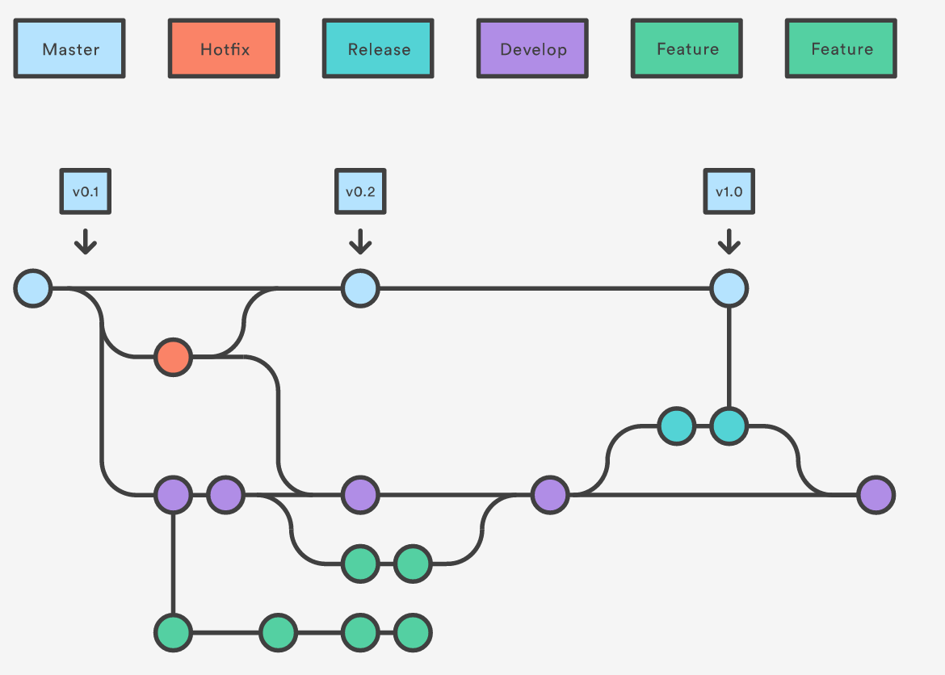
Gitflow Workflow
Forking Workflow vs Gitflow Workflow

Slide 15
Other Topics for Later
Tags and its usage
Git configuration
Git .gitignore
Git cherry-pick
Git filter-branch
Git submodules
Git format-patch
Git alias

Slide 16
Git GUI Clients
Xcode
Egit Eclipse Plugin(http://eclipse.org/egit/)
SourceTree(http://www.sourcetreeapp.com/)
http://git-scm.com/downloads/guis
Github for Mac
Tower
SmartGit

Slide 17
Demo
Command Line
GUI Client

Slide 18
References
Official Documentation: http://git-scm.com/doc
Learn Git in 15m: https://try.github.io/levels/1/challenges/1
GitHub Help: https://help.github.com/
Git Branching Strategy: http://nvie.com/posts/a-successful-git-branching-model/

